Slide 1


ELK Stack POC –
Server & Application Monitoring

Slide 2
Content
Overview of Setup
Visualizing ELK stack metrics
Visualizing server metrics
Create custom dashboards
Export custom dashboards
ELK Setup on CentOS/Debian EC2 instance
Application Performance Monitoring

Slide 3
ELK Stack Server Monitoring

Slide 4
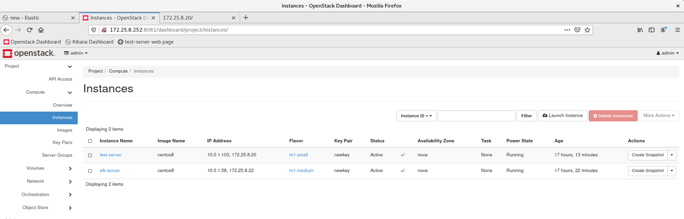
Overview of Setup
There are two instances deployed with metricbeat running on both –
elk-server (single node installation)
test-server

Slide 5
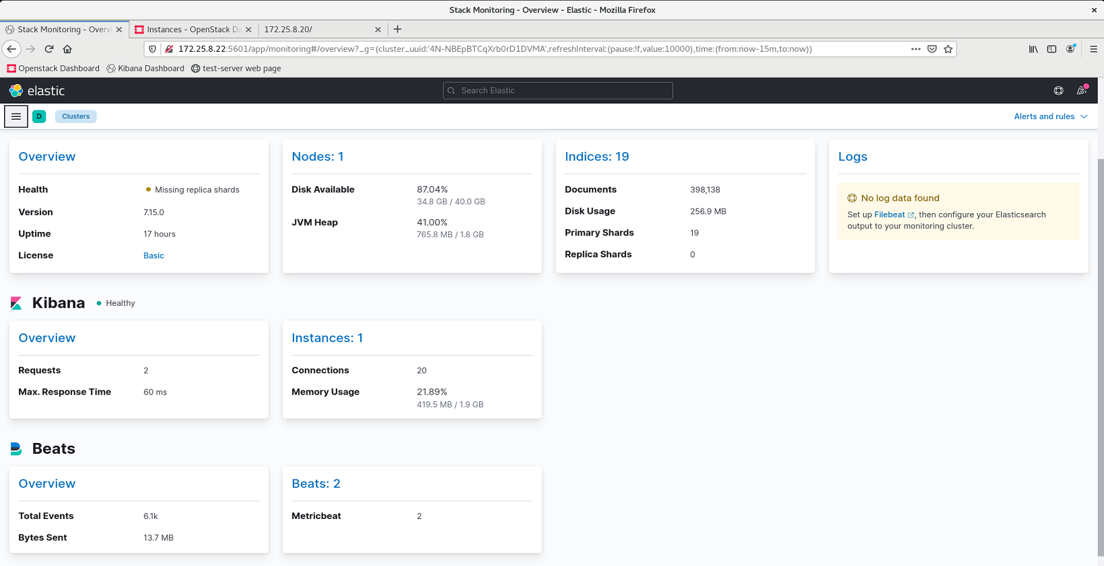
Stack Monitoring
There are 2 Metricbeat available - ElasticSearch & Kibana

Slide 6
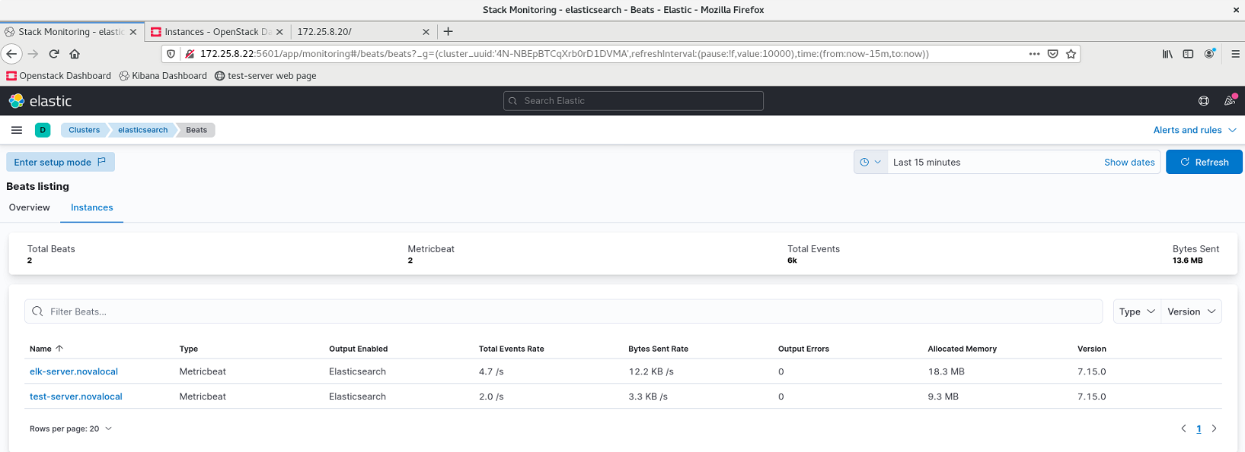
Click test-server.novalocal to view metrics

Slide 7
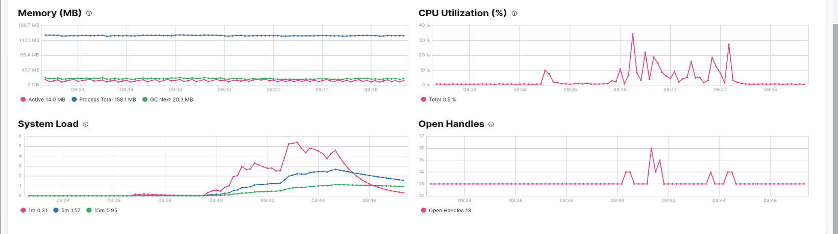
Below are the metrics for test-server.novalocal

Slide 8
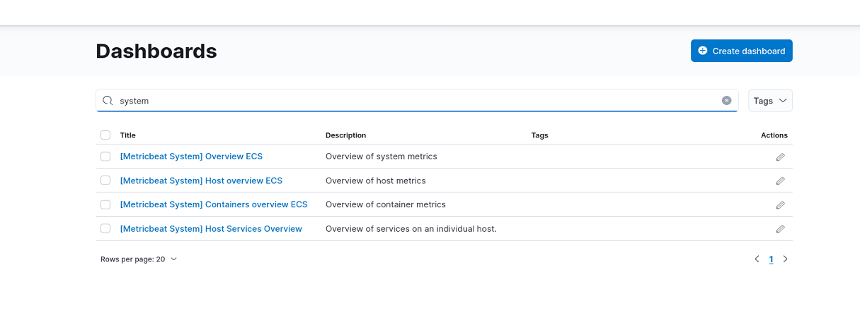
Host Metrics Overview
Search and select [Metricbeat system] Host overview ECS

Slide 9
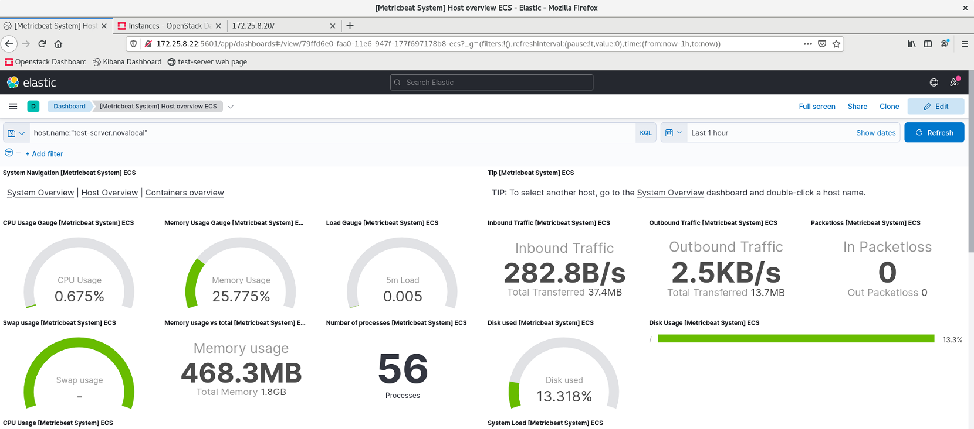
Below are the Host metrics for test-server.novalocal

Slide 10
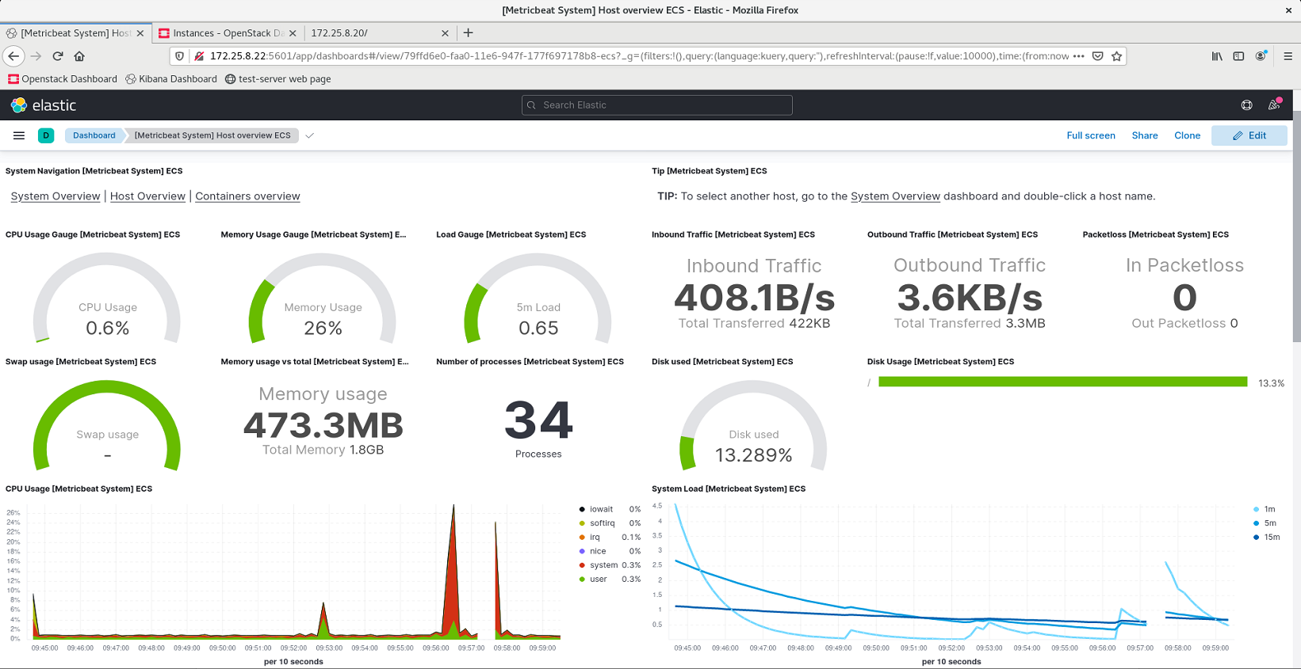

Slide 11
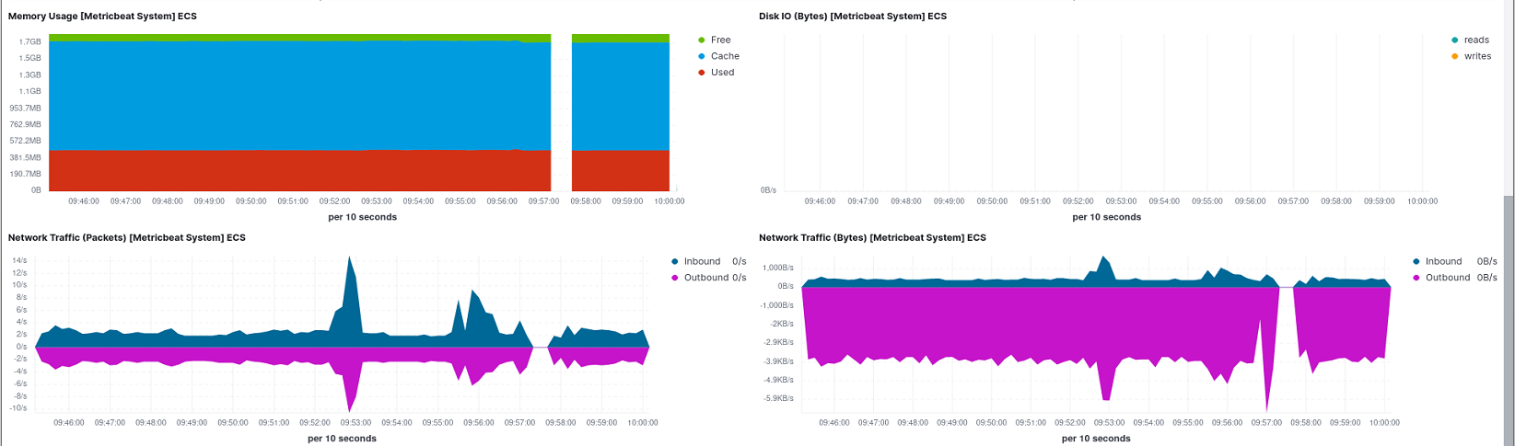
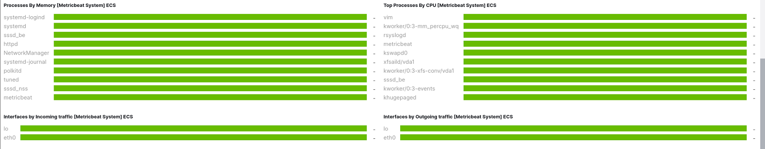

Slide 12
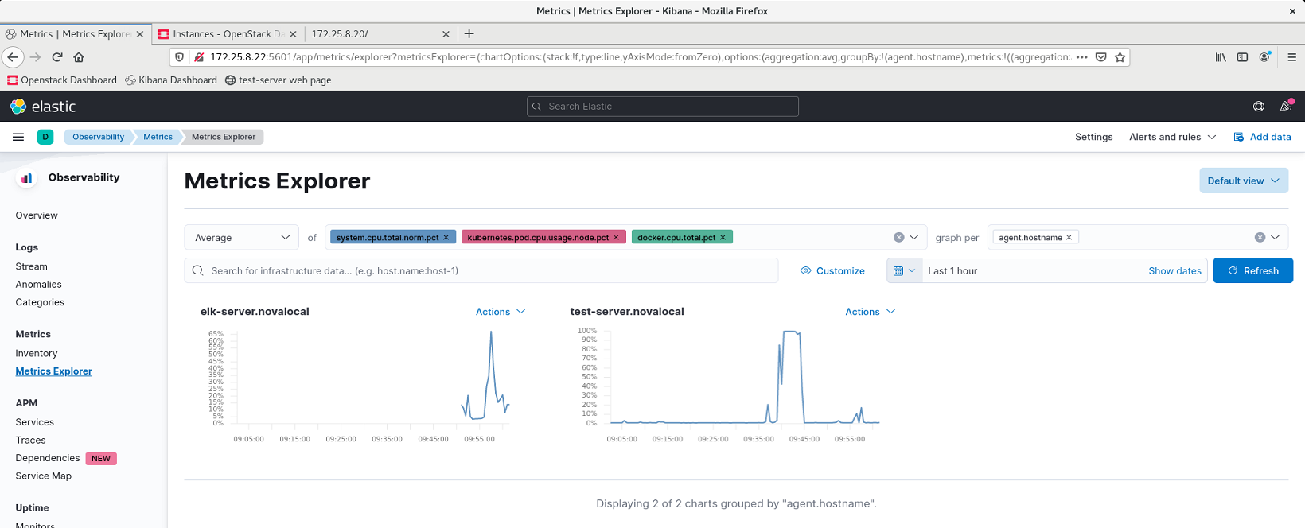
Create custom dashboard

Slide 13
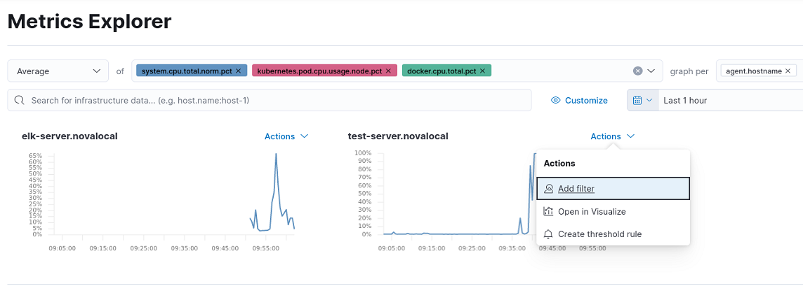
To save these graphs to a custom dashboard
Go to actions
Click Open in Visualize

Slide 14
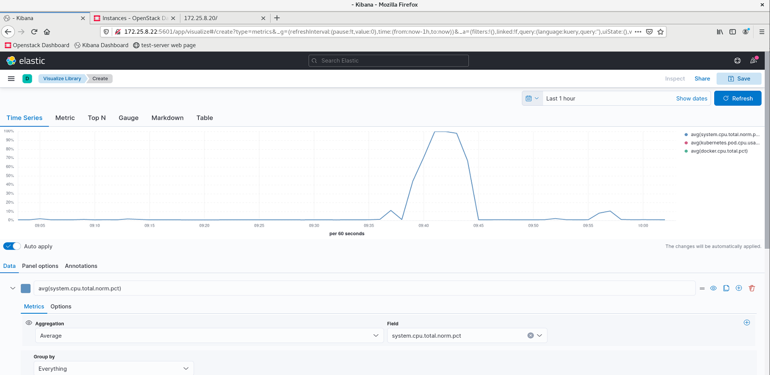

Slide 15
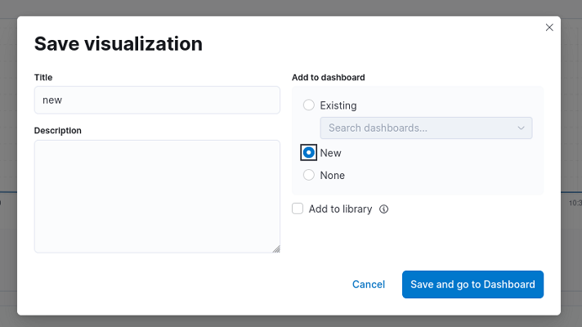
Give title and select new dashboard
Click save and go to Dashboard

Slide 16
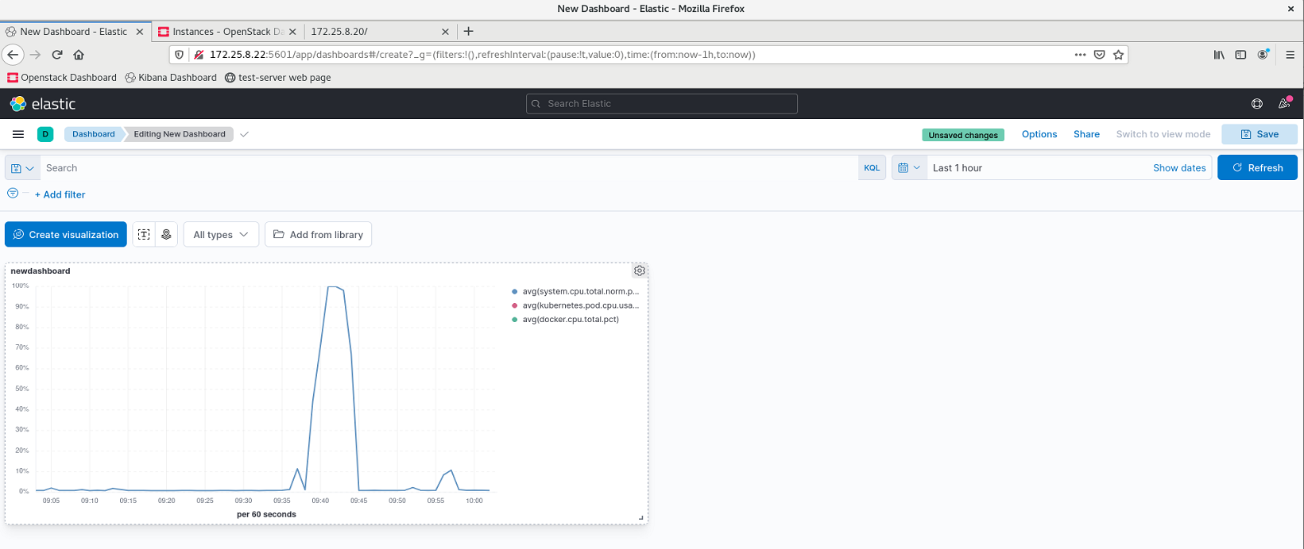

Slide 17
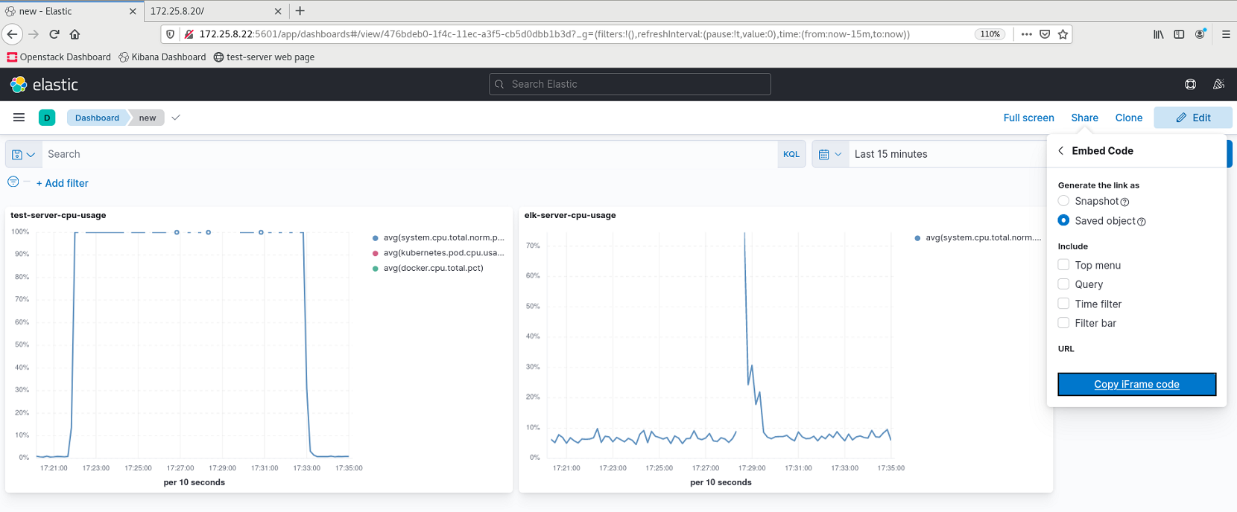
Export custom dashboards
Similarly, created 2 visualizations in the “new” dashboard

Slide 18
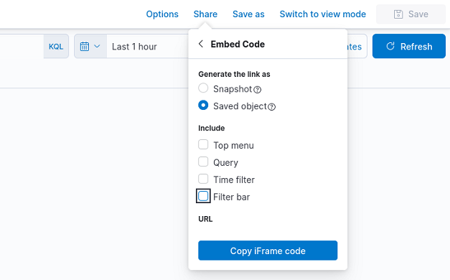
Select Saved object
Copy the iFrame code

Slide 19
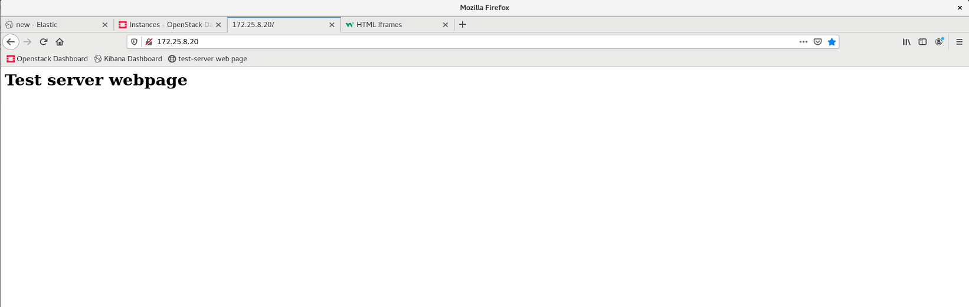
Host a webpage on test-server
Install httpd package in test-server for hosting webpage
Create index.html file in /var/www/html directory
Edit the index file with html code (for example: <h1>Test server webpage</h1>)
Start httpd service
Enter server’s ip and you can see the hosted webpage.

Slide 20
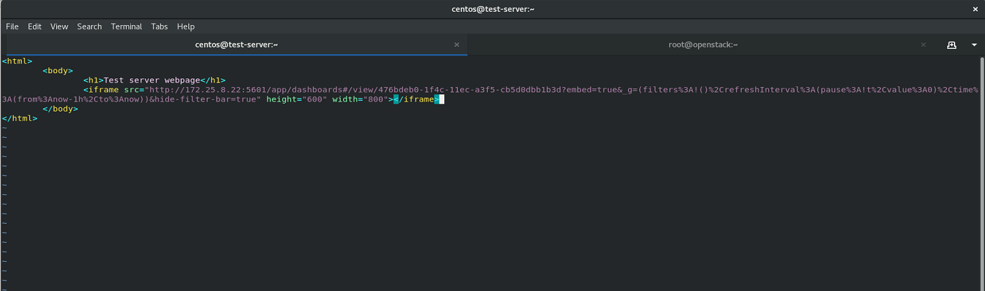
2. Export the custom dashboard to hosted webpage
Edit the index.html file
Insert the iframe copied from the Kibana dashboard in the html code.

Slide 21
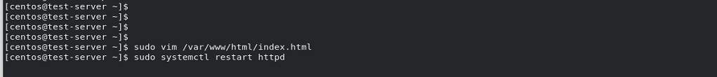
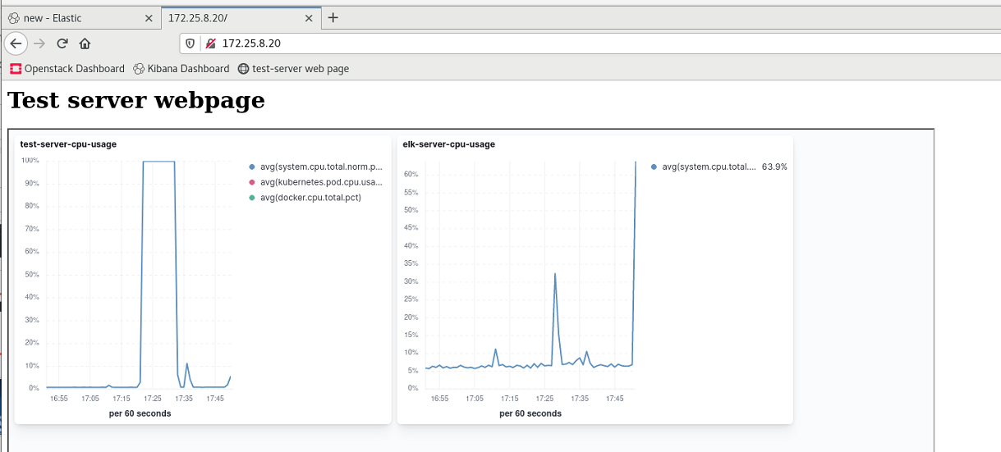
Restart the httpd service
View the custom dashboard on test-server’s webpage

Slide 22
ELK Stack – Application Performance Monitoring

Slide 23
ELK Setup on CentOS/Debian EC2 instance
Instance type : t3a.xlarge (4vCPU & 16 Gb)
Single node installation of Elastic & Kibana
Installation of APM Server.
Deployment of Java Application with MySQL Database.
Installation of APM Agent.

Slide 24
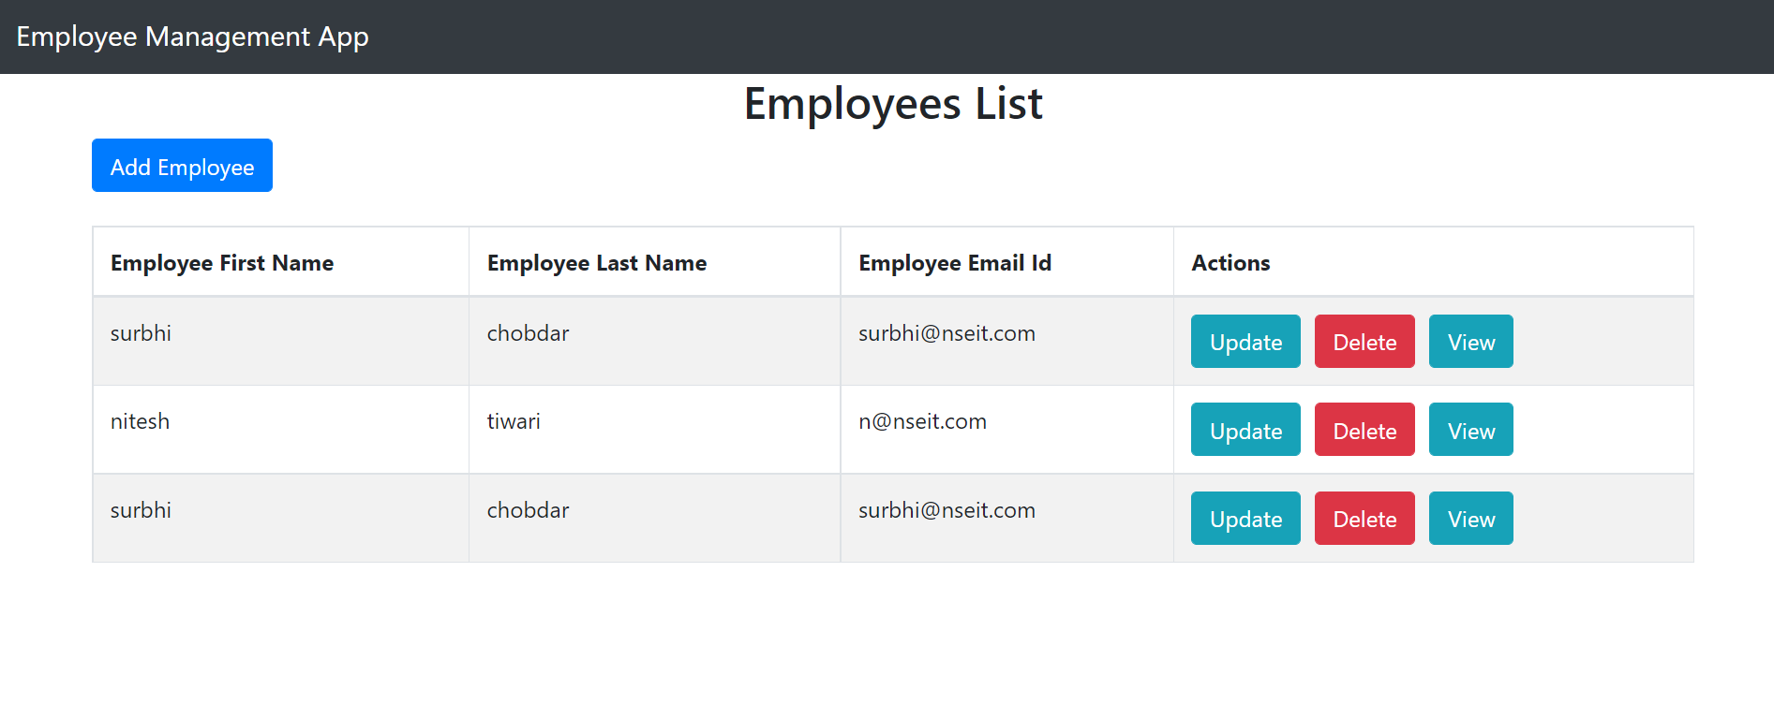
Deployment of the Application
Deployed an crud application with React js in frontend, SpringBoot in backend and MySQL for database.

Slide 25
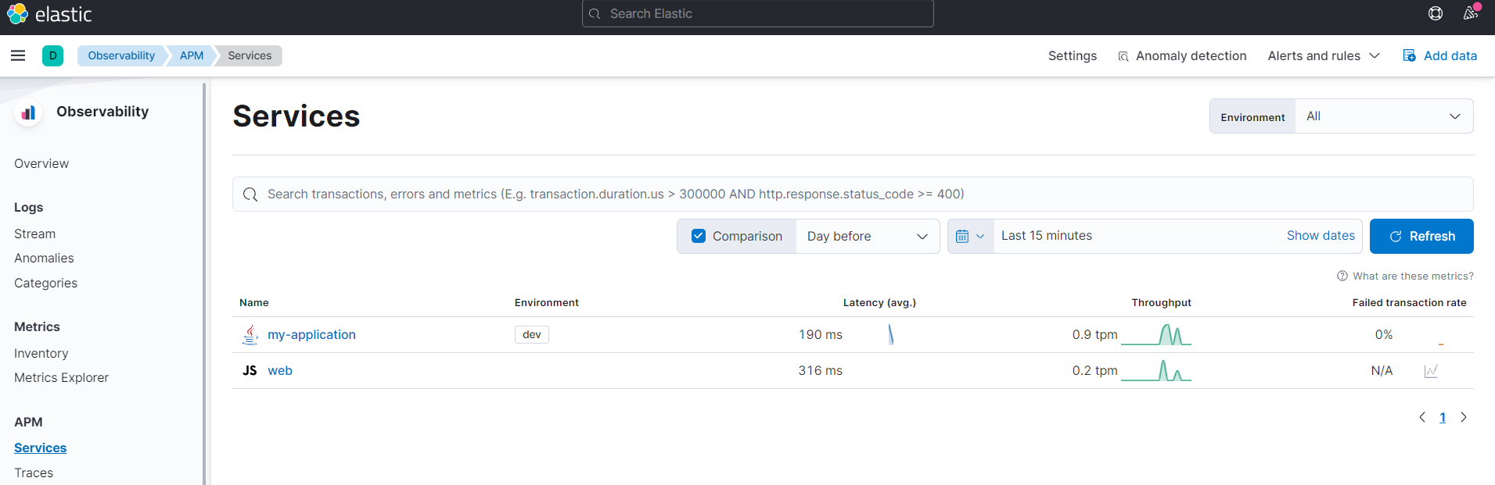
APM Services

Slide 26
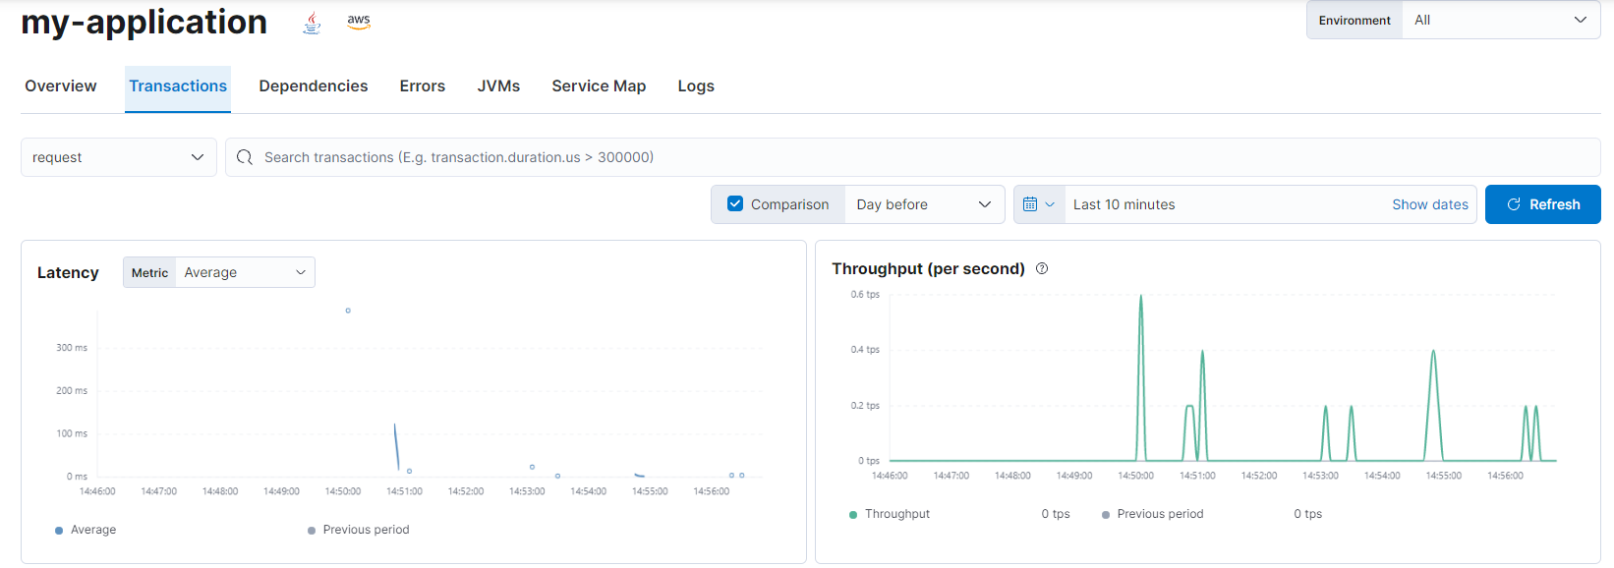
Java Application Metrics (Transaction)

Slide 27
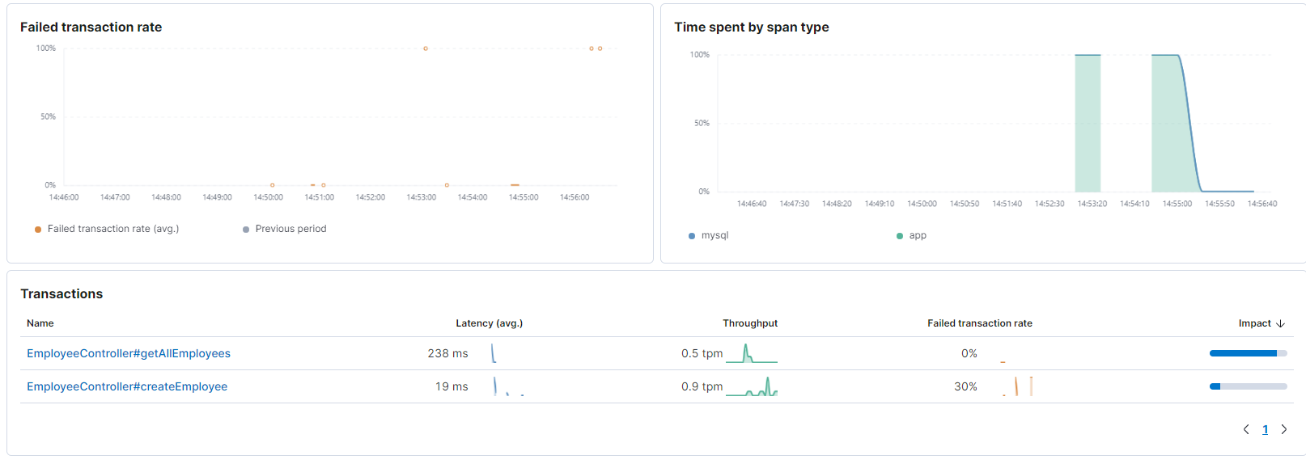
Java Application Metrics (Transactions)

Slide 28
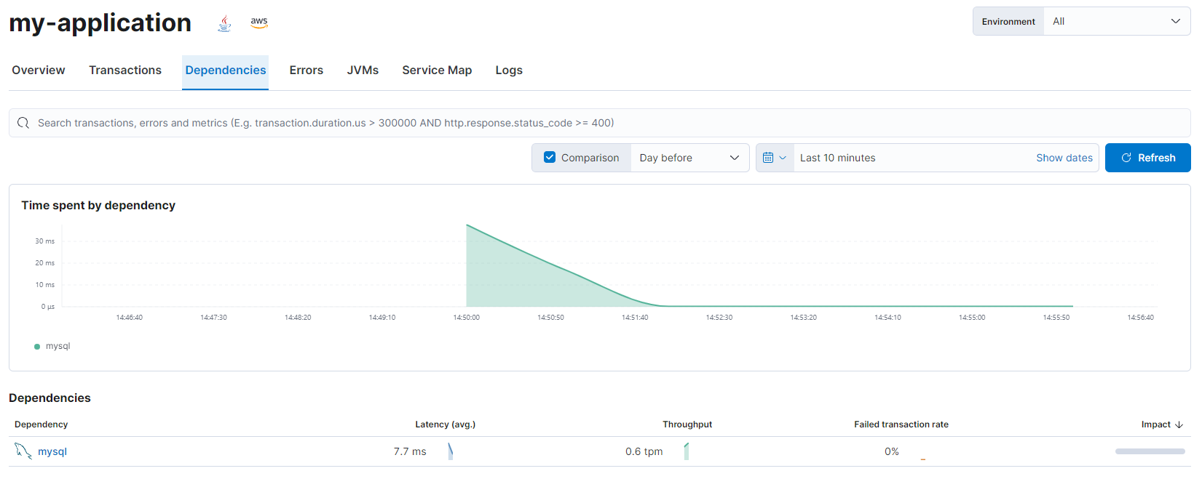
Java Application Metrics - Dependencies

Slide 29
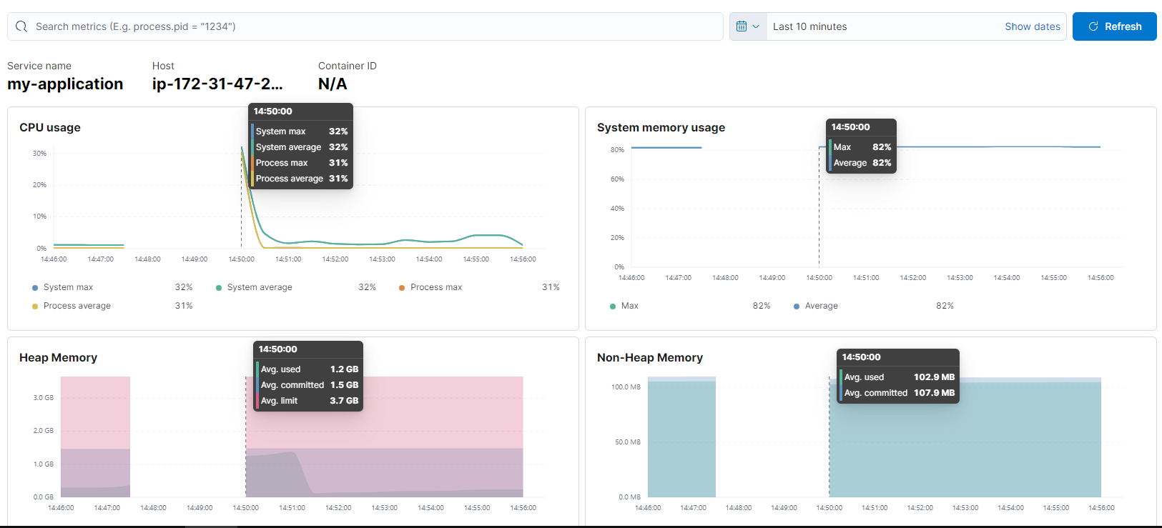
Visualization of JVM metrics:

Slide 30
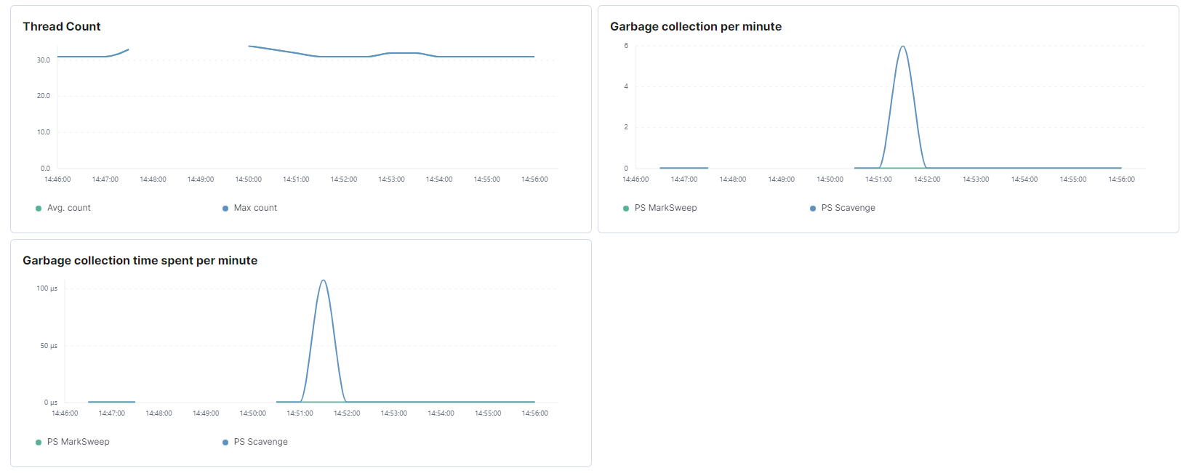

Slide 31
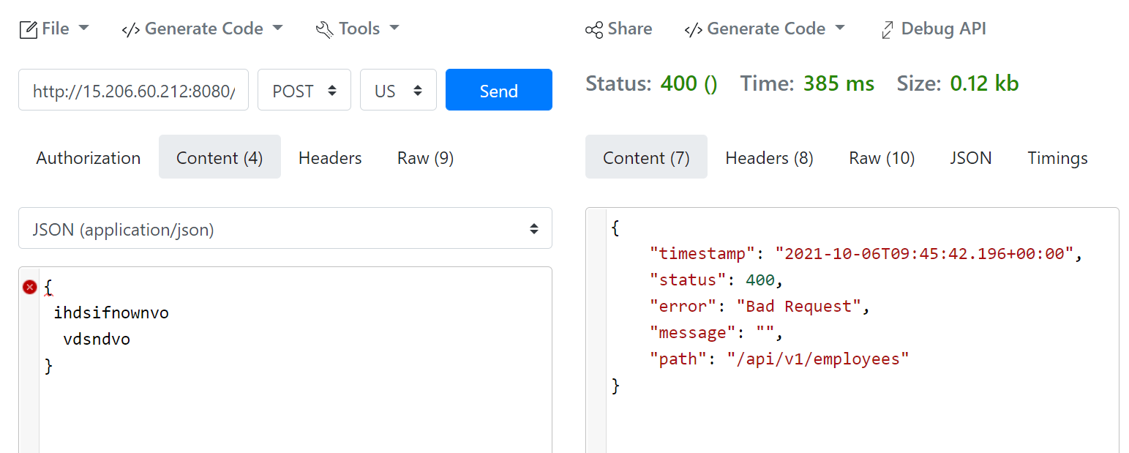
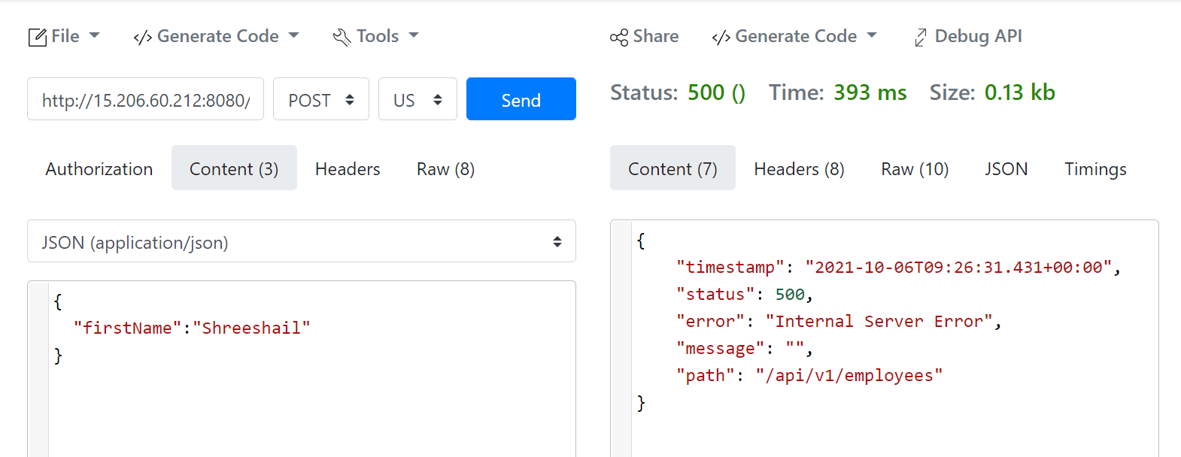
Error Detection
Posted a bad request to the API endpoint

Slide 32
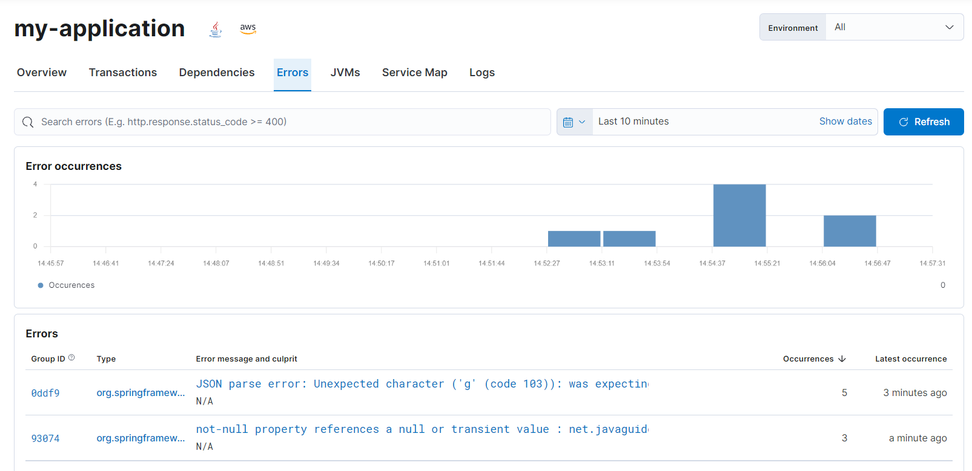
In the Errors tab APM is able to catch the error and visualize it:

Slide 33
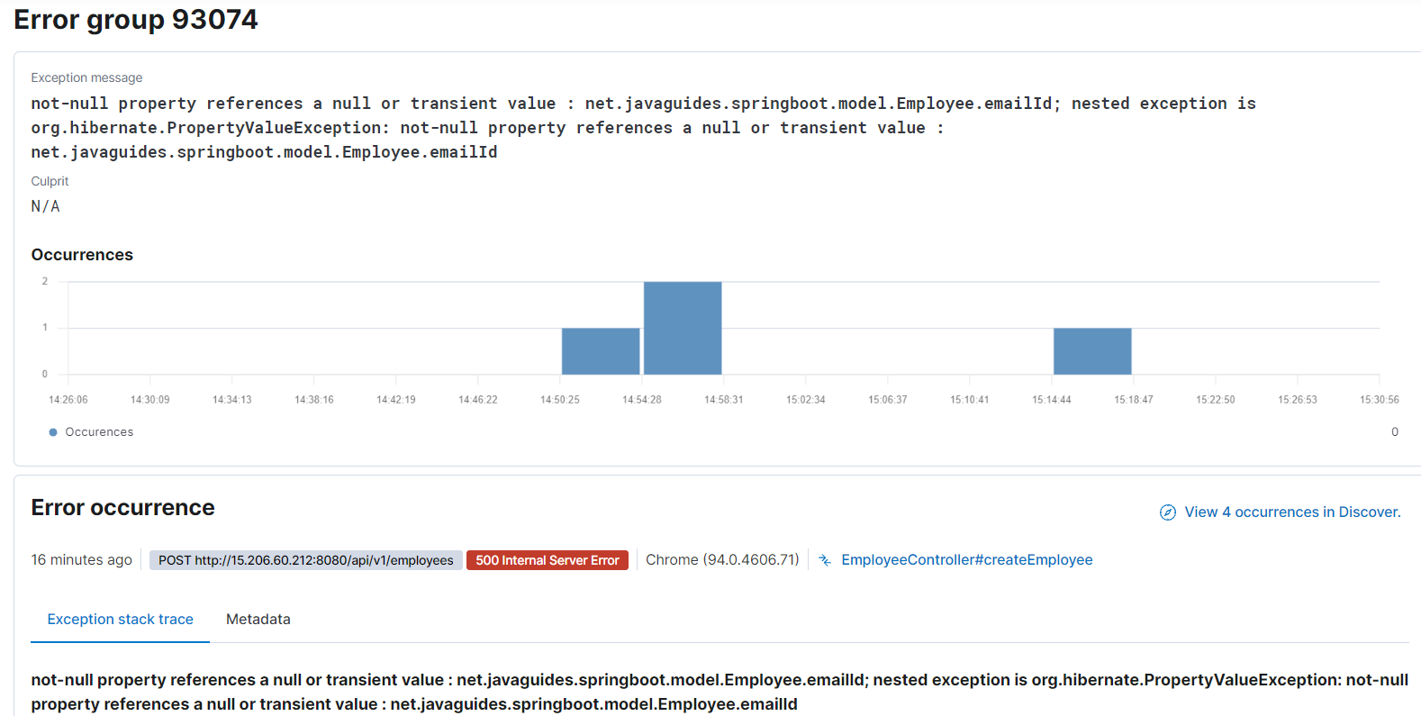
Expanding errors (Not null)

Slide 34
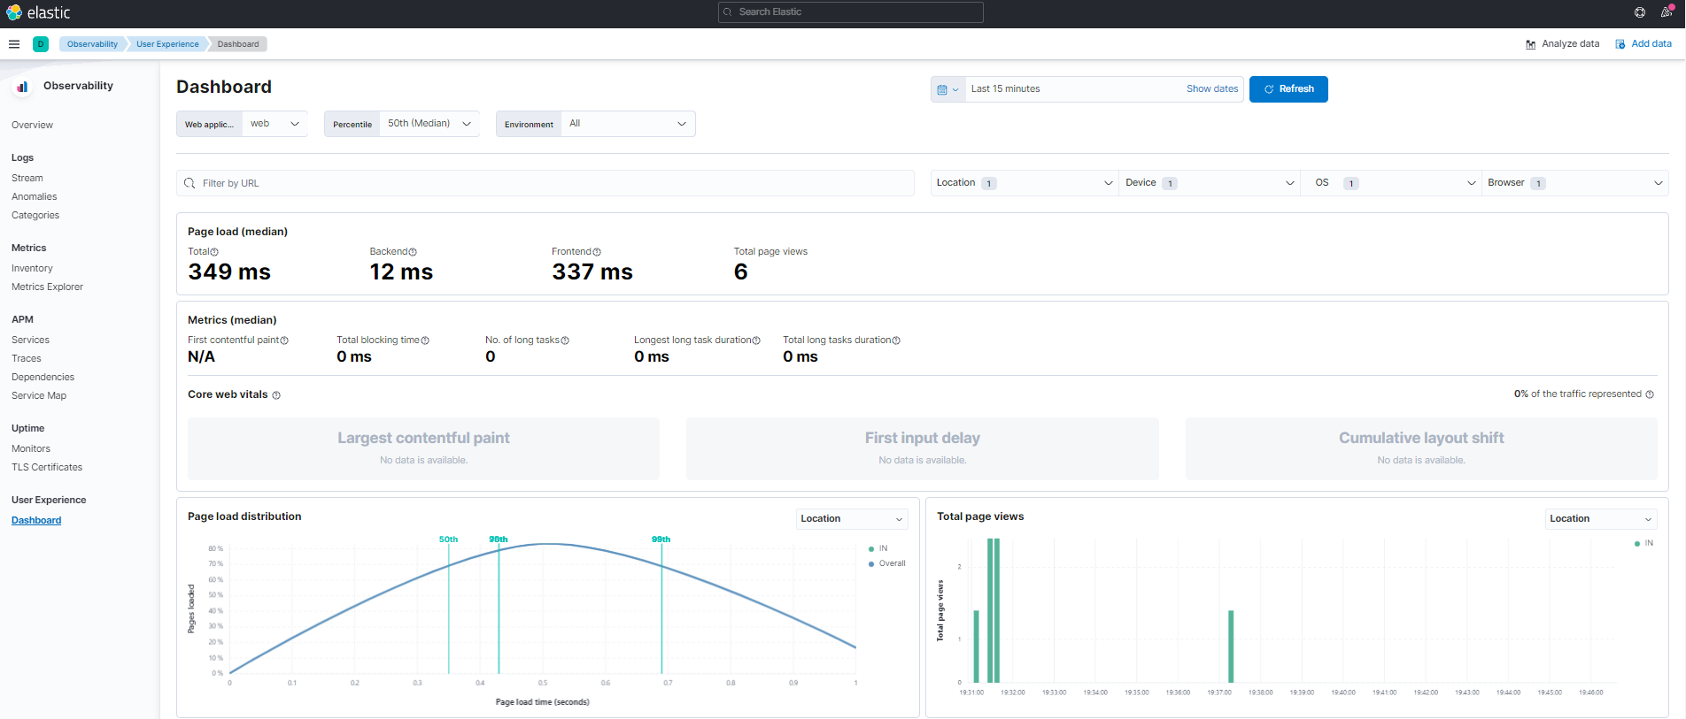
User Experience (based on RUM agent)

Slide 35
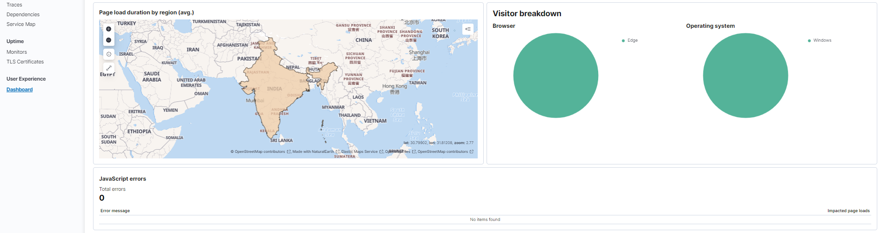

Slide 36
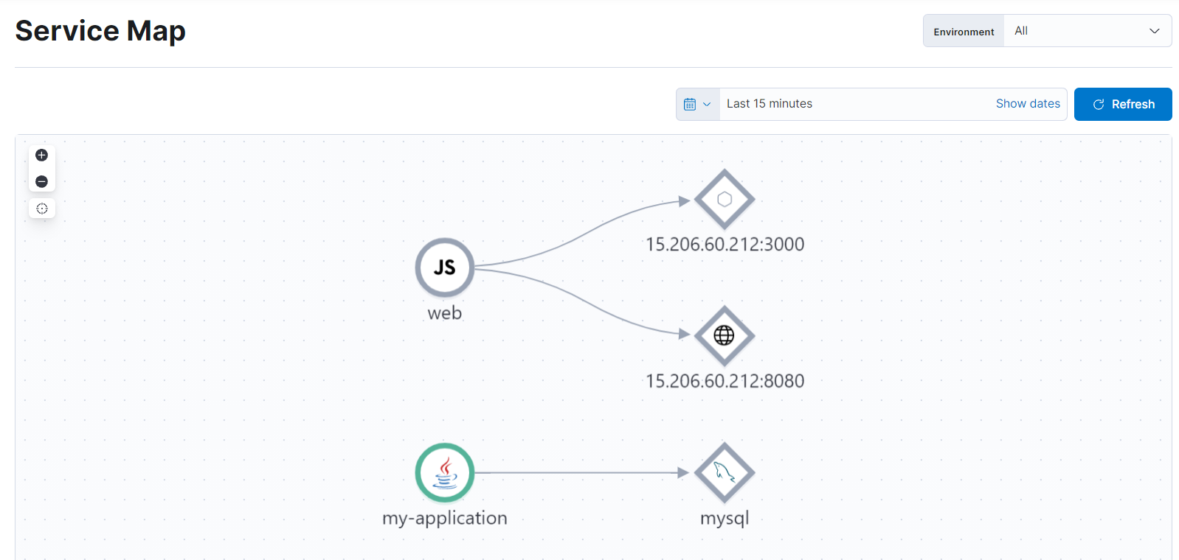
Service Map

Slide 37
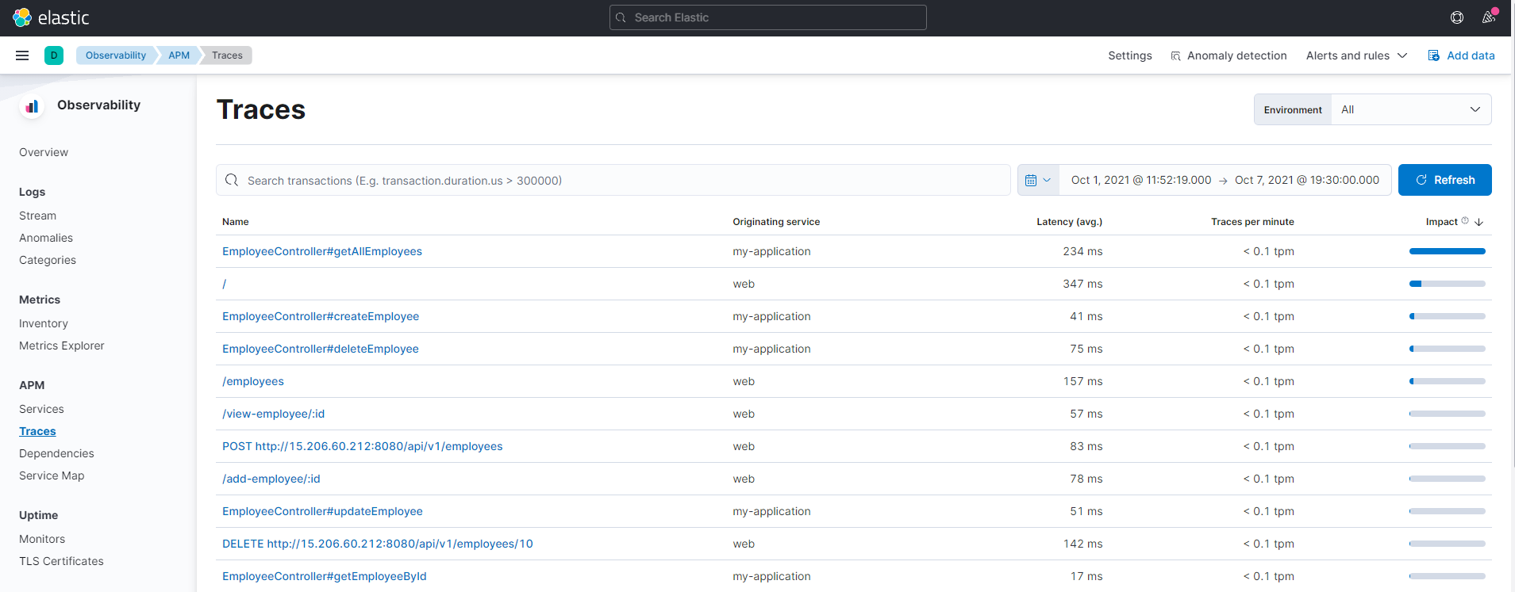
Traces
Traces shows most used API endpoints with respective latencies:

Slide 38
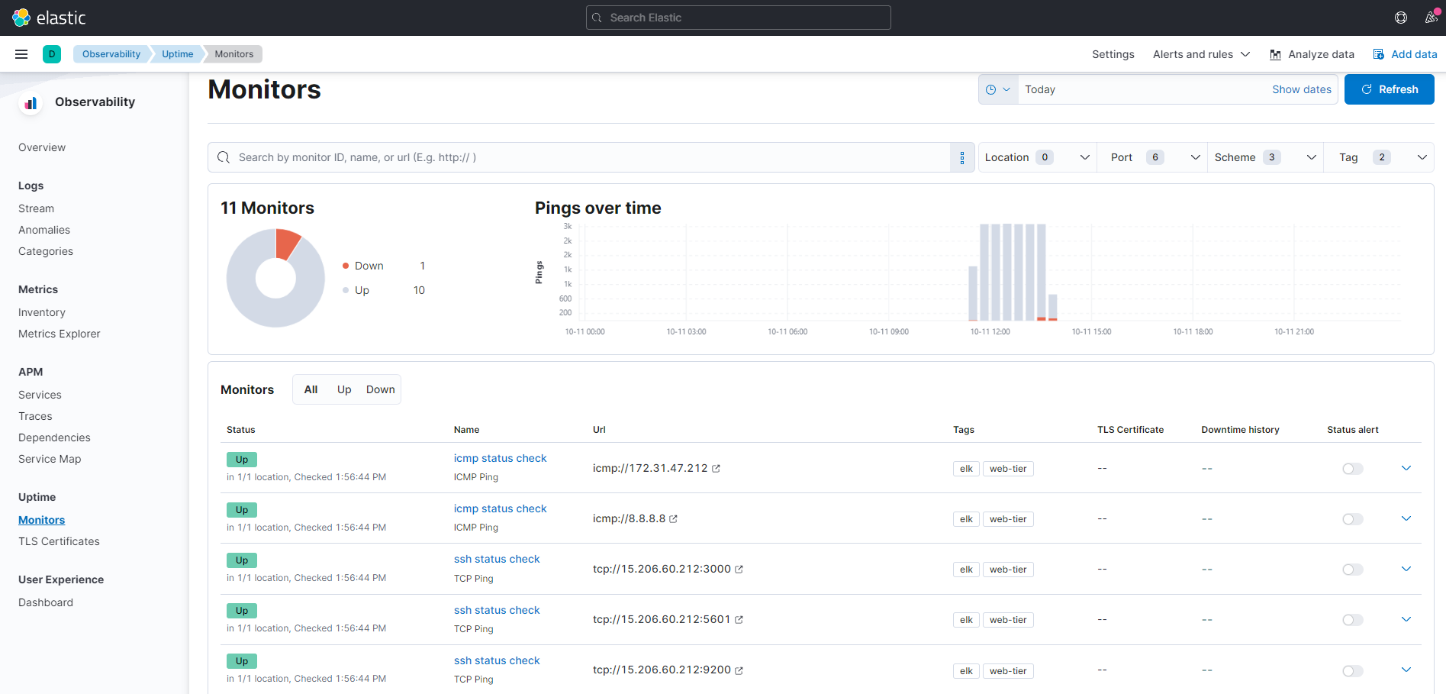
Uptime monitoring using Heartbeat

Slide 39
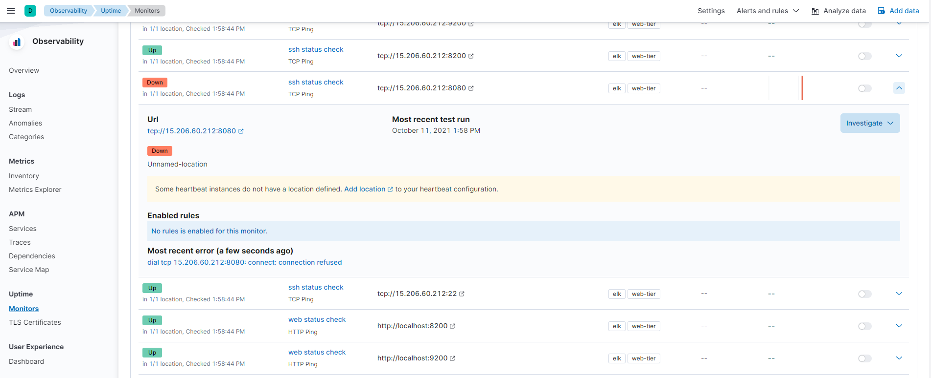
Application backend is hosted on port 8080

Slide 40
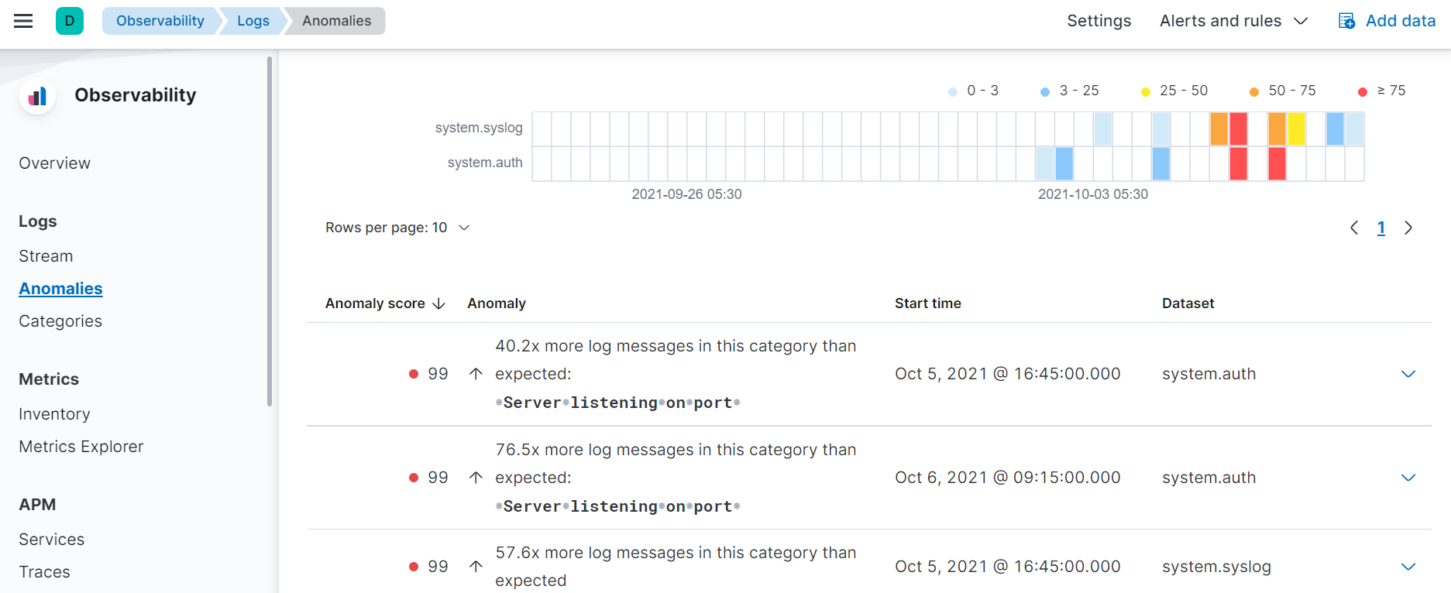
Anomalies
Anomalies Detection of the logs received from filebeat

Slide 41
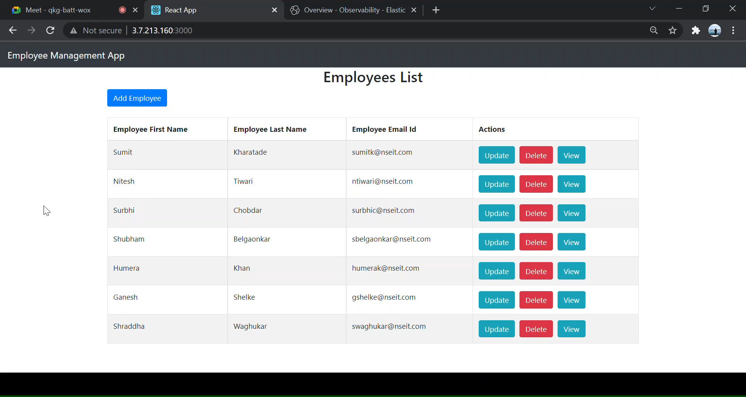

Slide 42

Thank You!

